Slide 1
PGST Meeting 2/6

Slide 2





Today's Agenda
Site visit summary
Propane consumption data
ReOPT Simulation
Next steps
Final questions

Slide 3
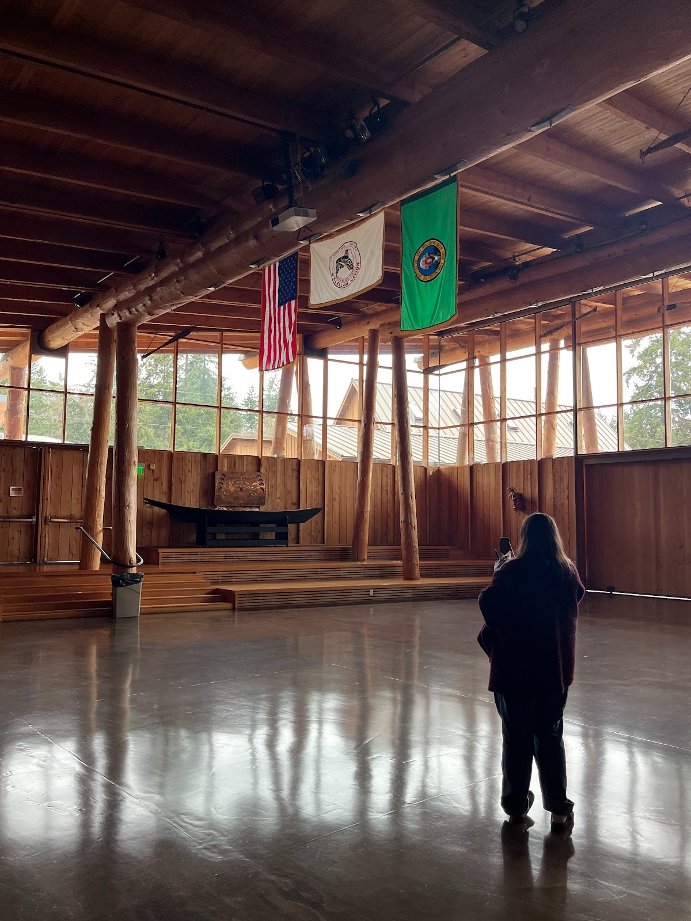
Site Visit
Main priorities & concerns
Education Center & Longhouse
Either too hot / too cold
Malfunctions with both heating and cooling systems.
Redundant pump systems.
Is Elder Center included in study?

Slide 4
Site Visit
Options for improvement
Improve energy envelope
Reduce redundant systems (conflicting thermostats, etc.)
Kurt responsible for maintenance
What is our role?
How should we handle the uneven and inefficient HVAC system in the Education Center? By estimating the reduction in energy usage by addressing these issues?

Slide 5
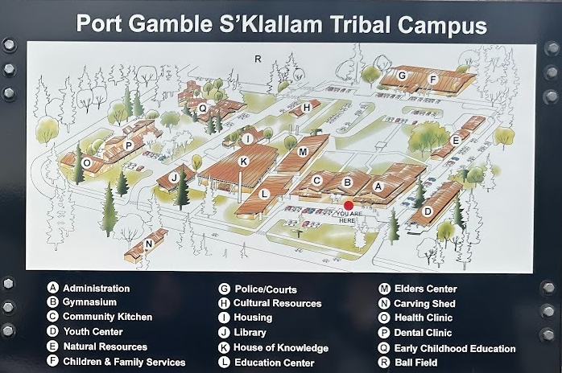
Site Visit
Where can PV be implemented?
Longhouse not viable structurally
South facing roofs
H, I, J, D, E
A, B, C (future remodel)

Slide 6
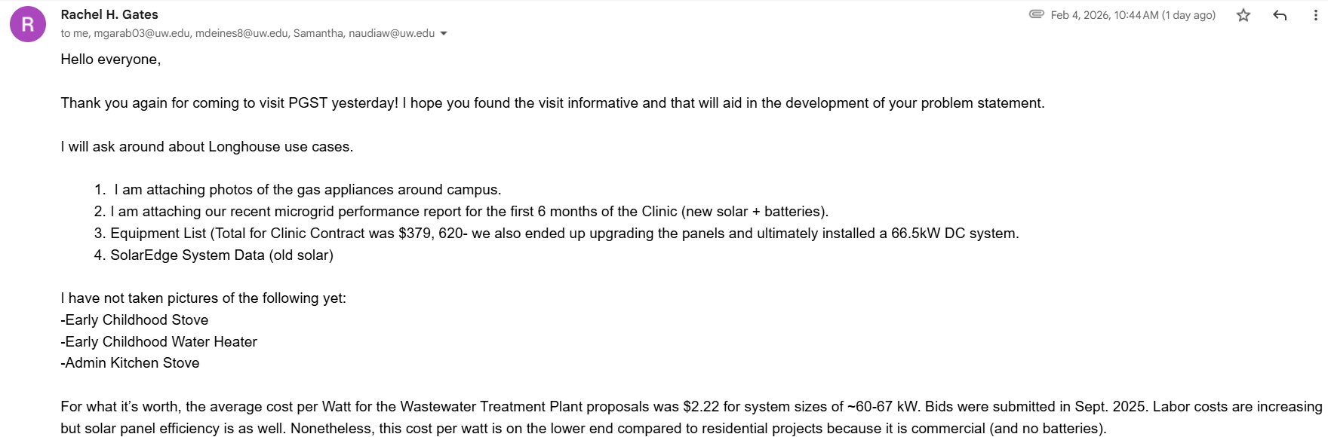

Additional Data
Post site visit Rachel sent us:
Photos of propane appliances around complex
Clinic microgrid performance reports
PV data for old and new solar system
Commercial, no-battery solar Wastewater Treatment Plant $/watt estimates
Thank you!

Slide 7
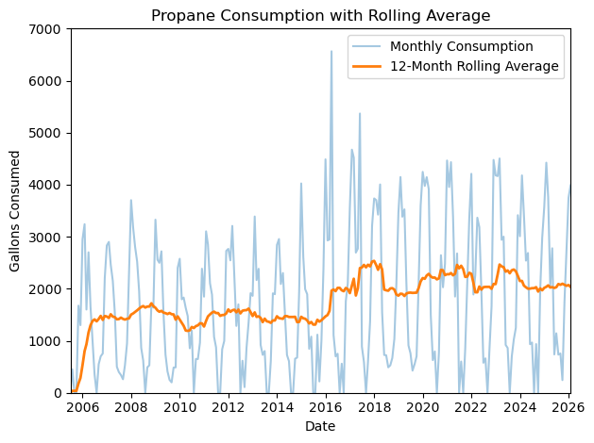
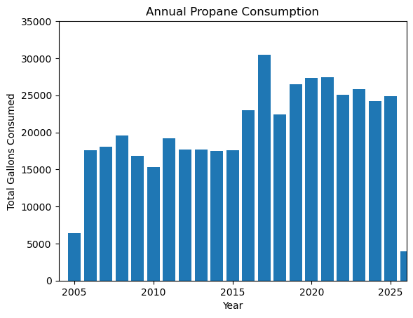
Propane Consumption

Slide 8
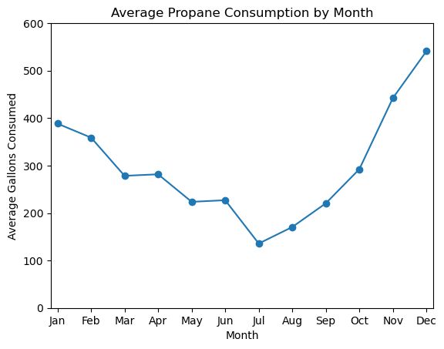
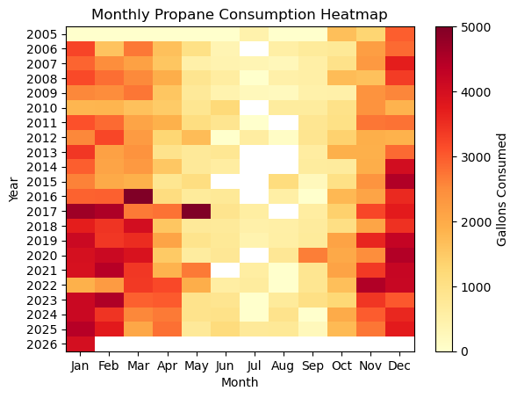
Propane Consumption

Slide 9
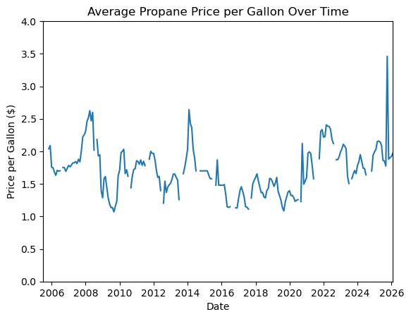
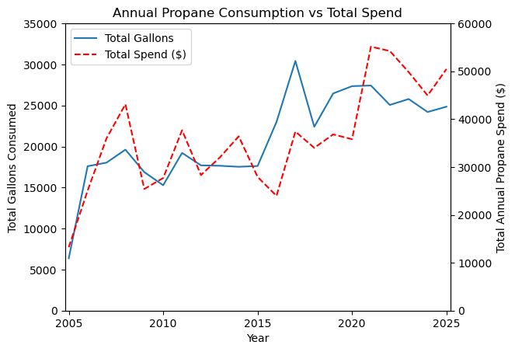
Propane Consumption

Slide 10

Propane Consumption
Key finding: Propane energy consumption was 14.7x electrical …

Slide 11
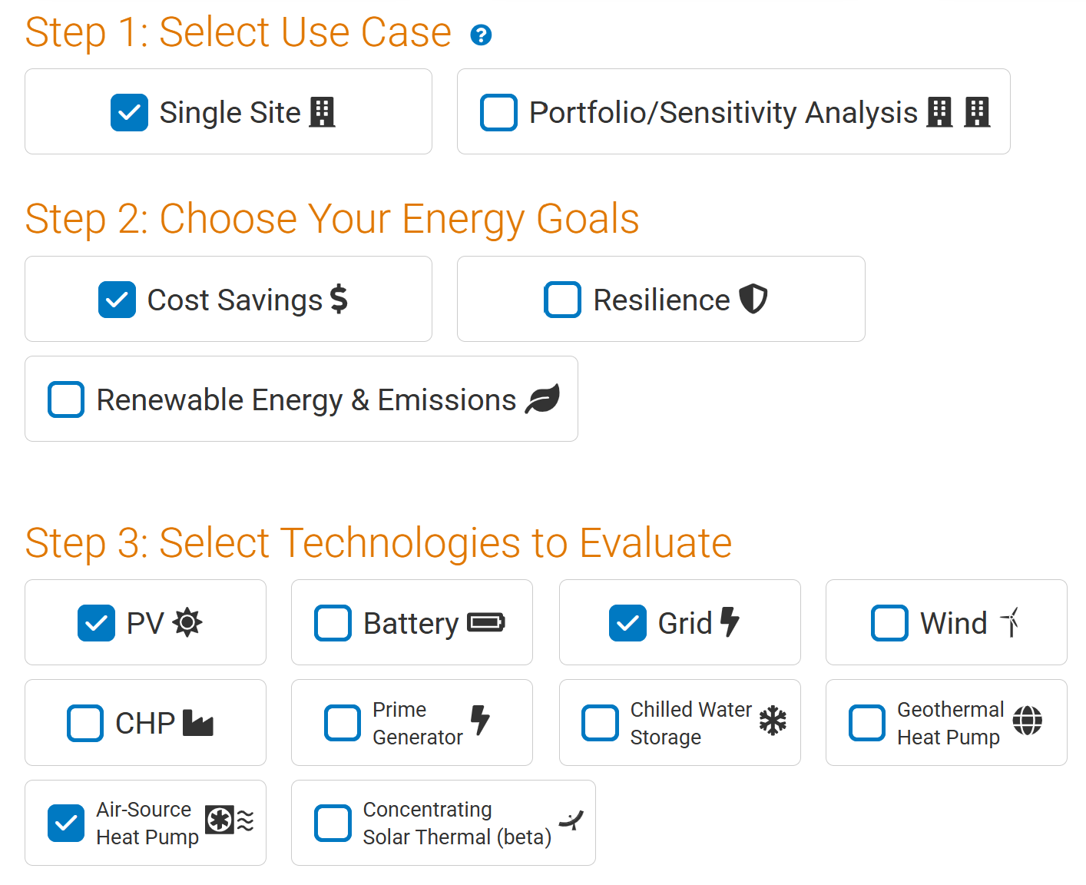
ReOpt
We ran a ReOpt simulation based on the annual electricity and propane data:
This software gives an estimation of how the system can be improved with the addition of PV systems.

Slide 12
ReOpt - Assumptions
Electricity rate: PSE Inc. 24 (General Service - 3 phase)
Compensation type: Net metering (full retail rate)
Net metering system size limit: 50 kW
Compensation for excess export beyond annual purchases: $0/kWh
Existing heating system fuel type: Propane ($2.5/gal)
Analysis period: 25 years
Electricity cost escalation rate: 1.66%/year
Propane cost escalation rate: 3.48%/year

Slide 13
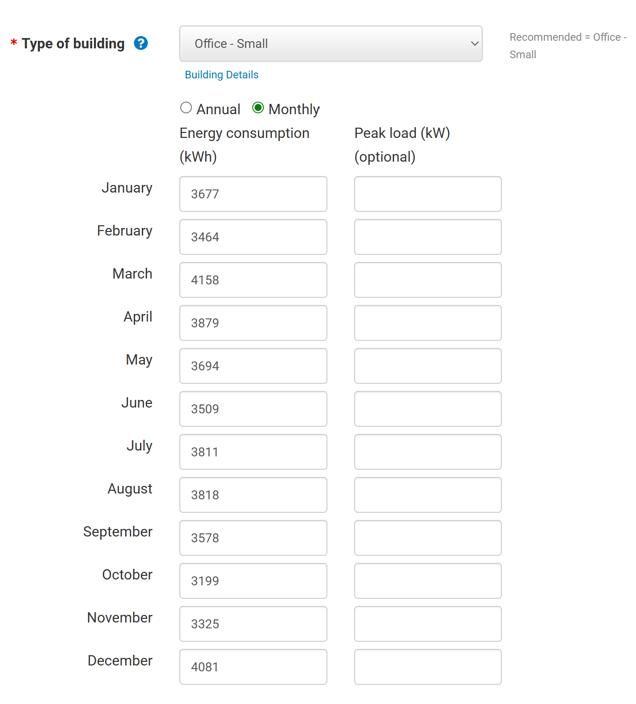
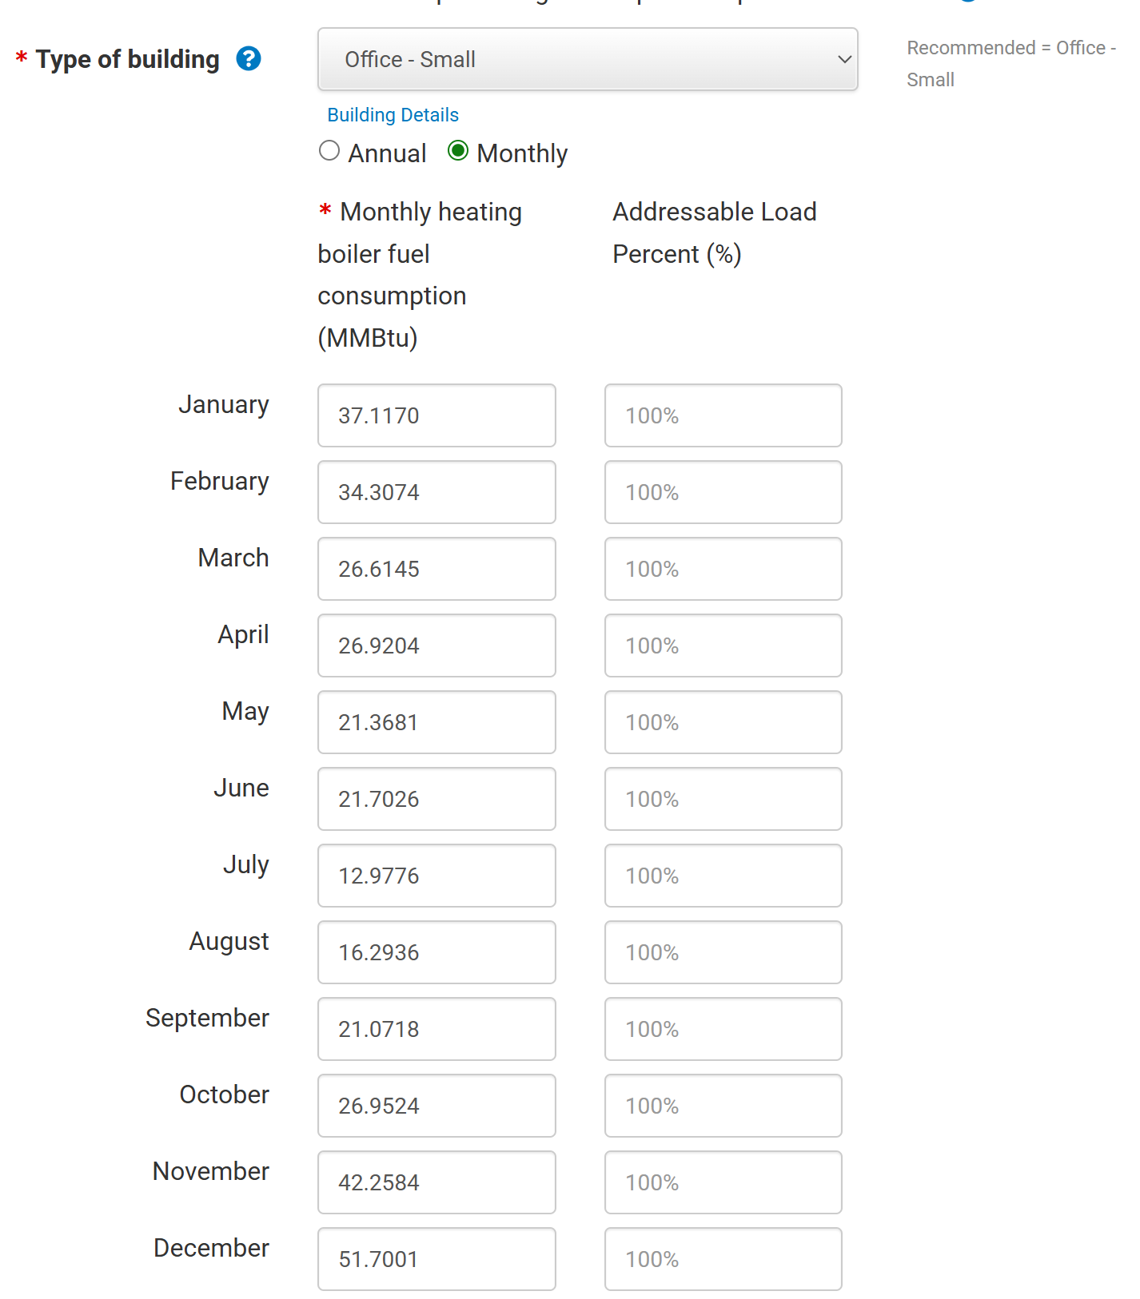
ReOpt - Inputs
Office building – small
Electricity consumption per month: Propane consumption per month:

Slide 14
ReOpt - Findings
Reasonable PV size
ReOpt approximates a financially optimized 45 kW PV size
Positive return on investment in the long-term
$73,945 life cycle savings over 25 years
Reduction in grid dependence
PV installation results in just over half the annual grid consumption (23,986 kWh compared to 44,193 kWh)
Capital cost estimates
Total before incentives: $100,440
About $2232/kW-DC

Slide 15
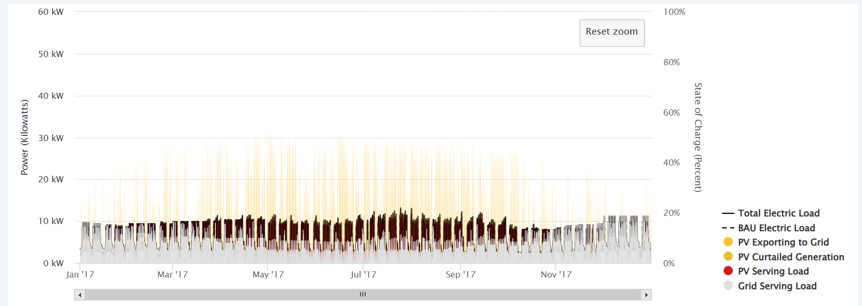
ReOpt - Findings
PV exports and grid usage:

Slide 16
Next Steps
Further analyze site visit information
Examine units manufacturing plates
Determine complex energy demand and capacity
Determine amount of heat pumps needed
Using complex capacity data
Offset propane usage (space heating)
Explore PV use to offset electricity usage
Estimate capital costs and energy savings

Slide 17
Questions
Are there any specific deliverables or deadlines you would like us to follow?
Any requests/advice in regards to the project?

Slide 18
Thank you!

